Slide 1
Object Oriented Programming using Java - Composition

Slide 2
Composition
The concept of composition is not new; that's what we do to describe complex objects in the real world:
Every living creature and most manufactured products are made up of parts. Often, each part is a subsystem that is itself made up of its own set of subparts. Together, the whole system forms a composition hierarchy.
Note the human body composition hierarchy on the next slide.
Remember that with a composition relationship, a component part is limited to just one owner at a time. For example, a heart can be in only one body at a time.

Slide 3
Composition
Prior to this chapter, all of our objects have been relatively simple, so we've been able to describe each object with just a single class.
But for an object that's more complex, you should consider breaking up the object into its constituent parts and defining one class as the whole and other classes as parts of the whole. When the whole class is the exclusive owner of the parts classes, then that class organization is called a composition.

Slide 4
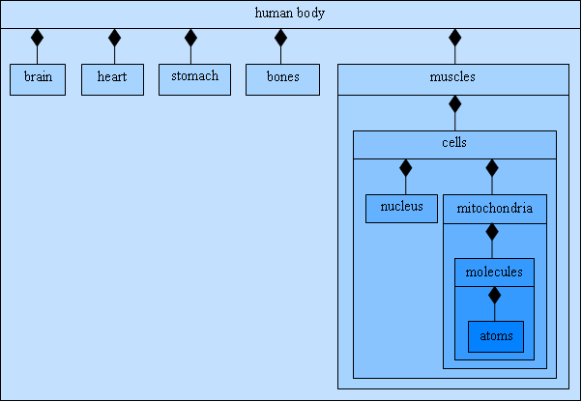
Composition
A partial composition hierarchy for the human body:

Slide 5
Composition
Composition
A class can have references to objects of other classes as members
Sometimes referred to as a has-a relationship
e.g., A car has an (has-a) engine
One form of software reuse is composition, in which a class has as members references to objects of other classes.

Slide 6
Composition (“Has-a”)
A composition relation exists between two classes if one classes’ field(s) consist of another class object
Class ABC
{
private XYZ x1;
}
ABC
XYZ
- XYZ x1;

Slide 7
Outline
Date.java
(1 of 3)

Slide 8
Outline
Validates month value
Date.java
(2 of 3)
Validates day value

Slide 9
Outline
Date.java
(3 of 3)
Check if the day is February 29 on a leap year

Slide 10
Outline
Employee contains references to two Date objects
Employee.java
Implicit calls to hireDate and birthDate’s toString methods

Slide 11
Outline
EmployeeTest.java
Create an Employee object
Display the Employee object

Slide 12
Exercise
Create a class Address with following Data members:
home;
street;
town;
city;
state;
Create constructors and set get methods for all data members.
Now create a class Person which contain “has-a” relation with Address class. It has data members : firstName and LastName.
Create constructors, set get methods and display function in Person Class

Slide 13
Exercise
Create an Address class, which contains street#, house#, city and code.
Create another class Person that contains an address of type Address, name and phone. Give constructors and appropriate get and set functions and a display function that prints all details of Person.
Test class person in main.
Create another class Book that contains an author of type Person. Other data members are bookName and publisher. Give constructors and a display function that prints all details of Book. Test class Book in main.

Slide 14
Write a command to change the address of the author of this book
Book b = new Book()
Address a = new Address(?,?)
B.getAuthor().setAddress(a)

Slide 15
Exercise
Create a class Job with following attributes:
Data Members: Designation, Salary, Id
Create constructors and setters and getters for all
Modify the Employee class (discussed in class) and add a Job Object as data member. Create a new method in Employee class that returns the Salary of the Employee.

